Slide 1
Recitation 3: Pointers
CS 0449: Introduction to Systems Software
Griffin Hurt
Griffin Hurt
Undergraduate Teaching Fellow
griffhurt@pitt.edu
https://griffinhurt.com
Spring 2024, Term 2244
Friday 2 PM Recitation
Feb 2nd, 2024
Slides adapted from
Shinwoo Kim, Martha Dixon, and Vinicius Petrucci
Department of Computer Science
School of Computing & Information
University of Pittsburgh
Course News
Pointers
Quiz (for completion)
Lab 2: Pointer Lab: Looking at Pointers!

Slide 2
Course News
Lab 2 is out, due February 8th 5:59PM

Slide 3
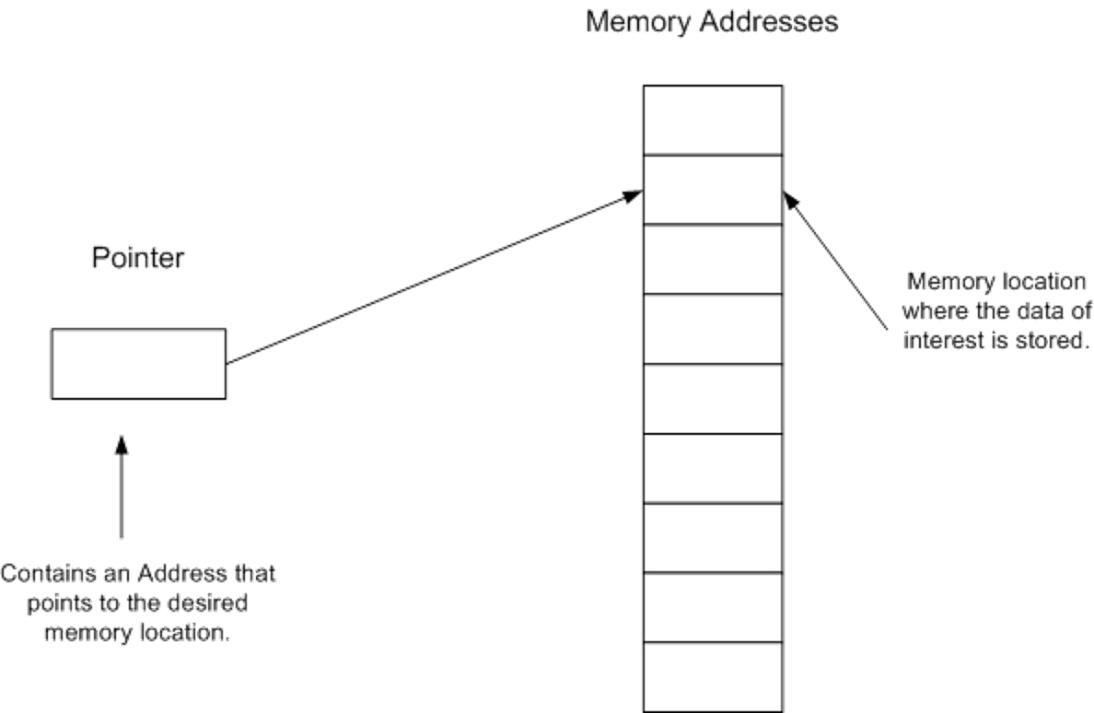
Pointers
Point to here, point to there, point to that, point to this, and point to nothing! well, they are just memory addresses!!??
Notes:
How comfortable are you with Pointers?

Slide 4
You've kinda used pointers in Java...
A pointer is a variable that contains a memory address
remember writing linked lists?
class Link {
Link next;
int value;
}
Link list = new Link();
list.next = new Link();
list.next.next = new Link();
next:
value: 0
next:
value: 0
next:
value: 0
what about a reference that doesn't refer to anything?
C has null too, but you have to yell it: NULL!
Notes:
- if you don't remember linked lists, welllllllll get your 445 textbook out cuz you’ll need it for malloc() project… coming soon

Slide 5
Pointers are variables, so they have a type
The type describes what kind of data it points to
An int has type int
A pointer to an int has type int*
A pointer to a pointer to an int has type int**
Expressions also have a type
If x has type int, then x+4 also has type int
If x has type int, then &x has type int*
If p has type int*, then *p has type int
If p has type int*, then &p has type int**

Slide 6
Pointers are variables, so they store data
a variable is a named piece of memory
a pointer is a variable that holds a memory address
int x = 0x100;
int y = 0x200;
int* px = &x;
int* py = &y;
Name | Address | Value
x | DC00 | 0100
y | DC04 | 0200
px | DC08 | DC00
py | DC0C | DC04
since pointers are variables, can you get their addresses?
the addresses of these variables are given to us automatically by the compiler-ish
Notes:
- "ish" because when we learn about the stack, you'll see that the addresses of local variables can differ depending on where on the stack they are executing
- but the compiler gives you the offsets of those variables from the stack pointer.
- yes. yes, you can.

Slide 7
Declaring pointers
in Java, how do you declare an array of any type X?
you put square brackets after the type: X[]
int[]
int*
an array that holds ints.
an pointer to an int.
int[][]
int**
an array that holds arrays,
and each of those holds ints.
a pointer to a pointer, which points to an int.
a C pointer can point to either a single value or an array of that type.
Notes:
- the meaning of the pointer – single value or array – depends on context.
- really, non-array variables are just arrays of length 1… ;)
- often, but not always, you can think of a pointer as pointing to an array of values… and a double-pointer is almost always a 2D array

Slide 8
The address-of operator (&)
when used as a prefix operator, & means "address of"
it gives you the memory address of any variable, array item, etc.
the address is given to you as a pointer type
i.e. it "adds a star" I know it seems backwards, why wouldn't they make * add a star, or name pointers int& right?
use it on an int?
you get an int*
use it on an int*?
you get an int**
YOU GET THE IDEA I hope
you can use it on just about anything with a name
&x
&arr[10]
&main (yep!) _{google function pointers in C!}
Notes:
We'll talk about function pointers at a later date

Slide 9
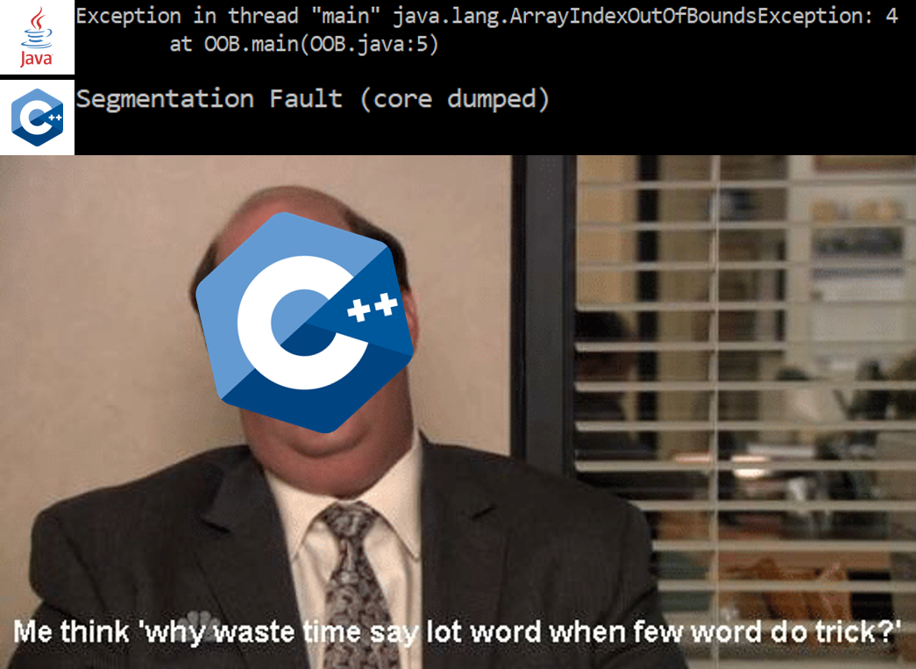
Accessing the value(s) at a pointer

Slide 10
The value-at (or "dereference") operator
* is the value-at operator
it dereferences a pointer
that is, it accesses the memory that a pointer points to
it's the inverse of &
every time you use it, you remove a star again, this feels backwards?
int** ppx = ...
int* px = *ppx;
int x = *px;
goes to the address that ppx contains, and gets the int* there
goes to the address that px contains, and gets the int there
Notes:
- you might think of it like a little breadcrumb… it's the "follow the breadcrumb" operator (look up "Hansel and Gretel")
- so an int** is two breadcrumbs that lead you to an int…
- idk I thought it was cute

Slide 11
Arrays are just pointers ^{well…sort of}
In C, array names are just aliases that can be used as pointers
int y[] = {2, 3, 4, 5}; // these two are
int *y = {2, 3, 4, 5}; // roughly equivalent
Indexing and dereferencing pointers are equivalent
Side note: you can do math with pointers…this is called pointer arithmetic.
when you use the array indexing operator, you're really just adding an offset to the pointer, and using that as the address to access.
*y ≡ y[0] *(y+1) ≡ y[1]
2
3
4
5
int*
int
int
int
int
y

Slide 12
Pointer types are important!
If x is an int*8_t*, x[3] access elements at byte offset 3 ✕ 1 = 3
If x is an int*32_t*, x[3] access elements at byte offset 3 ✕ 4 = 12
0
4
8
12
2
3
4
5
int32_t
int32_t
int32_t
int32_t
0
1
2
3
2
3
4
5
int8_t
int8_t
int8_t
int8_t
int32_t*
y
int8_t*
y

Slide 13
Pointer arithmetic
Name | Address | Value
array[3] | DC0C | 3
array[2] | DC08 | 2
array[1] | DC04 | 1
array[0] | DC00 | 0
if we write this:
int array[] = {0, 1, 2, 3};
memory looks like this:
if we want to access array[2]...
what is that equivalent to?
*(array + 2)
but how big is each item in the array? (what is sizeof(int)?)
when we write array + 2, we don't get 0xDC02, we get 0xDC08
it adds the size of 2 items to the address
when you add or subtract offsets to pointers, C "scales" the offsets by multiples of the size of the type they point to.
Notes:
- each item is, in this case, 4 bytes long (sizeof(int) == 4)
- keep in mind that array indexes and byte addresses are different things!!
- this is why C has to know what a pointer points to – so it can do this math correctly. (in addition to catching bugs. (sorta.))

Slide 14
Oh yeah, and that stupid -> operator
if you have a pointer to a struct, you must access its fields with: ->
Food* pgrapes = &produce[0];
pgrapes->price = 2.99;
(*pgrapes).price = 2.99;
these are identical in meaning.
Notes:
- go look at 4_food_struct.c again!

Slide 15
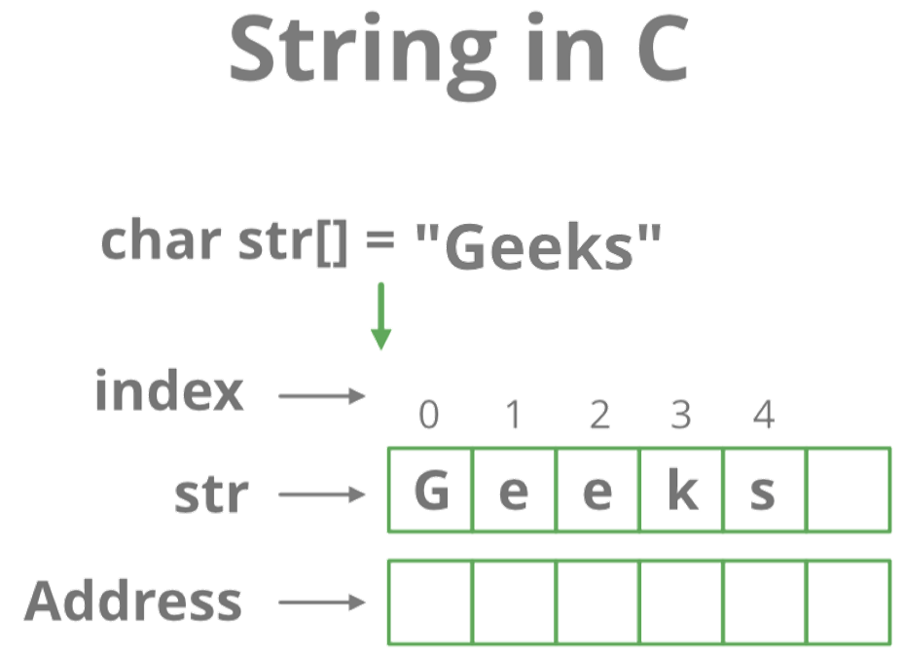
Common pointer patterns
I.e., String = char[] = char*

Slide 16
Every problem in CS...
...can be solved with another level of indirection/references/pointers.
pointers are the basis of:
strings
arrays
object-oriented programming
dynamic memory management
pretty much everything your operating system does
pretty much everything... everything does.
higher level languages often give you more abstract, safer ways of achieving the same things that you can do with pointers
Notes:
At a systems level, pointers are the basis for solving all sorts of problems in CS

Slide 17
Multi-dimensional arrays
we already saw single-dimensional arrays, but…
int** arr2d = ...
 |  |  |  | …
1 | 9 | 4 | 3 | 0 | 7 | 6
a Java int[][] works exactly the same way!
2 | 2 | 0 | 0 | 5 | 3 | 9
6 | 0 | 4 | 3 | 7 | 7 | 7
1 | 2 | 3 | 4 | 5 | 6 | 7
Notes:
- THIS IS ACTUALLY COMPLETELY DIFFERENT FROM AN "int arr[4][6];" OR SOMETHING
- see 5_2d_arrays.c for a comparison

Slide 18
Pass-by-reference
often you want to give another function access to your variables.
fgets(buffer, 100, stdin);
int x, y;
function_that_returns_two_values(&x, &y);
since these functions have access to buffer, x, and y, they can change their values.

Slide 19
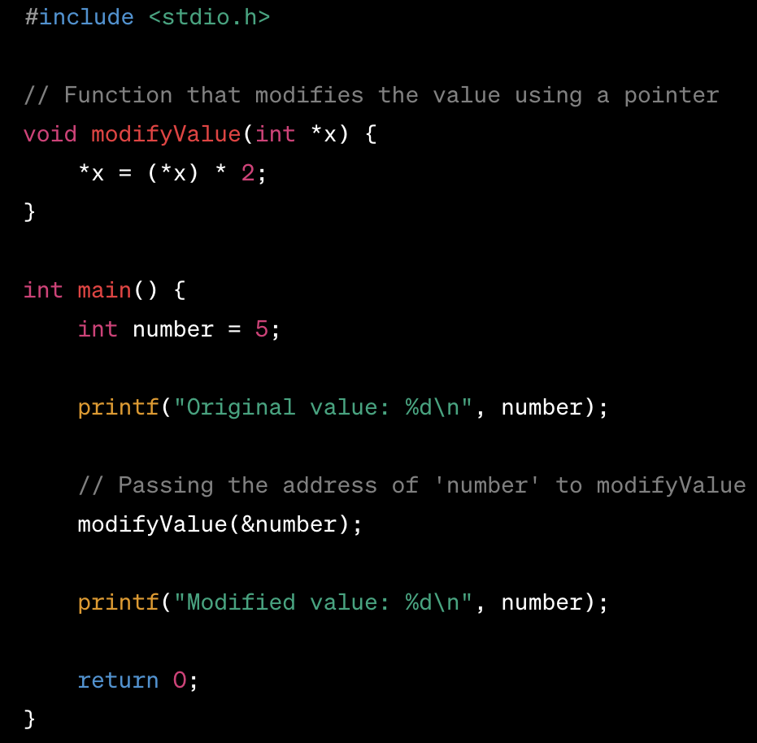
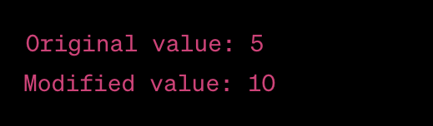
Pass-by-reference (example)

Slide 20
Quiz Time!
(Again, just for completion)
Password: ______

Slide 21
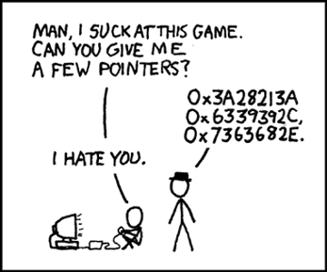
Pointer Lab
Solve a series of short coding puzzles to better understand how pointers work!
Notes:
Used to be a two week project with more restrictions on what you could/could not use.
Has been simplified into a one week lab

Slide 22
Getting set up
Download the starter code:
On Thoth:
wget https://cs0449.gitlab.io/sp2024/labs/02/pointerlab-handout.zip -O pointerlab-handout.zip
Unzip to your private directory on Thoth
unzip pointerlab-handout.zip
Creates a directory called pointerlab-handout that contains a number of files
You will modify only the file pointer.c

Slide 23
pointer.c
Skeleton for some programming exercises
Comment block that describes exactly what the functions must do
and what restrictions there are on their implementation.

Slide 24
TASK: Pointer Arithmetic
Goal
Compute the size (how much memory a single one takes up, in bytes) of an int
Hint
Arrays of ints allocate contiguous space in memory so that one element follows the next.

Slide 25
TASK: Manipulating Data Using Pointers
Motive/Goal
Manipulate data in new ways with your new knowledge of pointers
swapInts() - swap the values that two given pointers point to (without changing the pointers themselves)
serializeBE() - change the value of the elements of an array to contain the data in an int.
Use big-endian order.
You are not permitted to use [] syntax to access or change elements in the array anywhere in the pointer.c file.
deserializeBE() - does the opposite operation of serializeBE().
The serializeBE()/deserializeBE() functions emulate what would happen when sending an int through the internet.

Slide 26
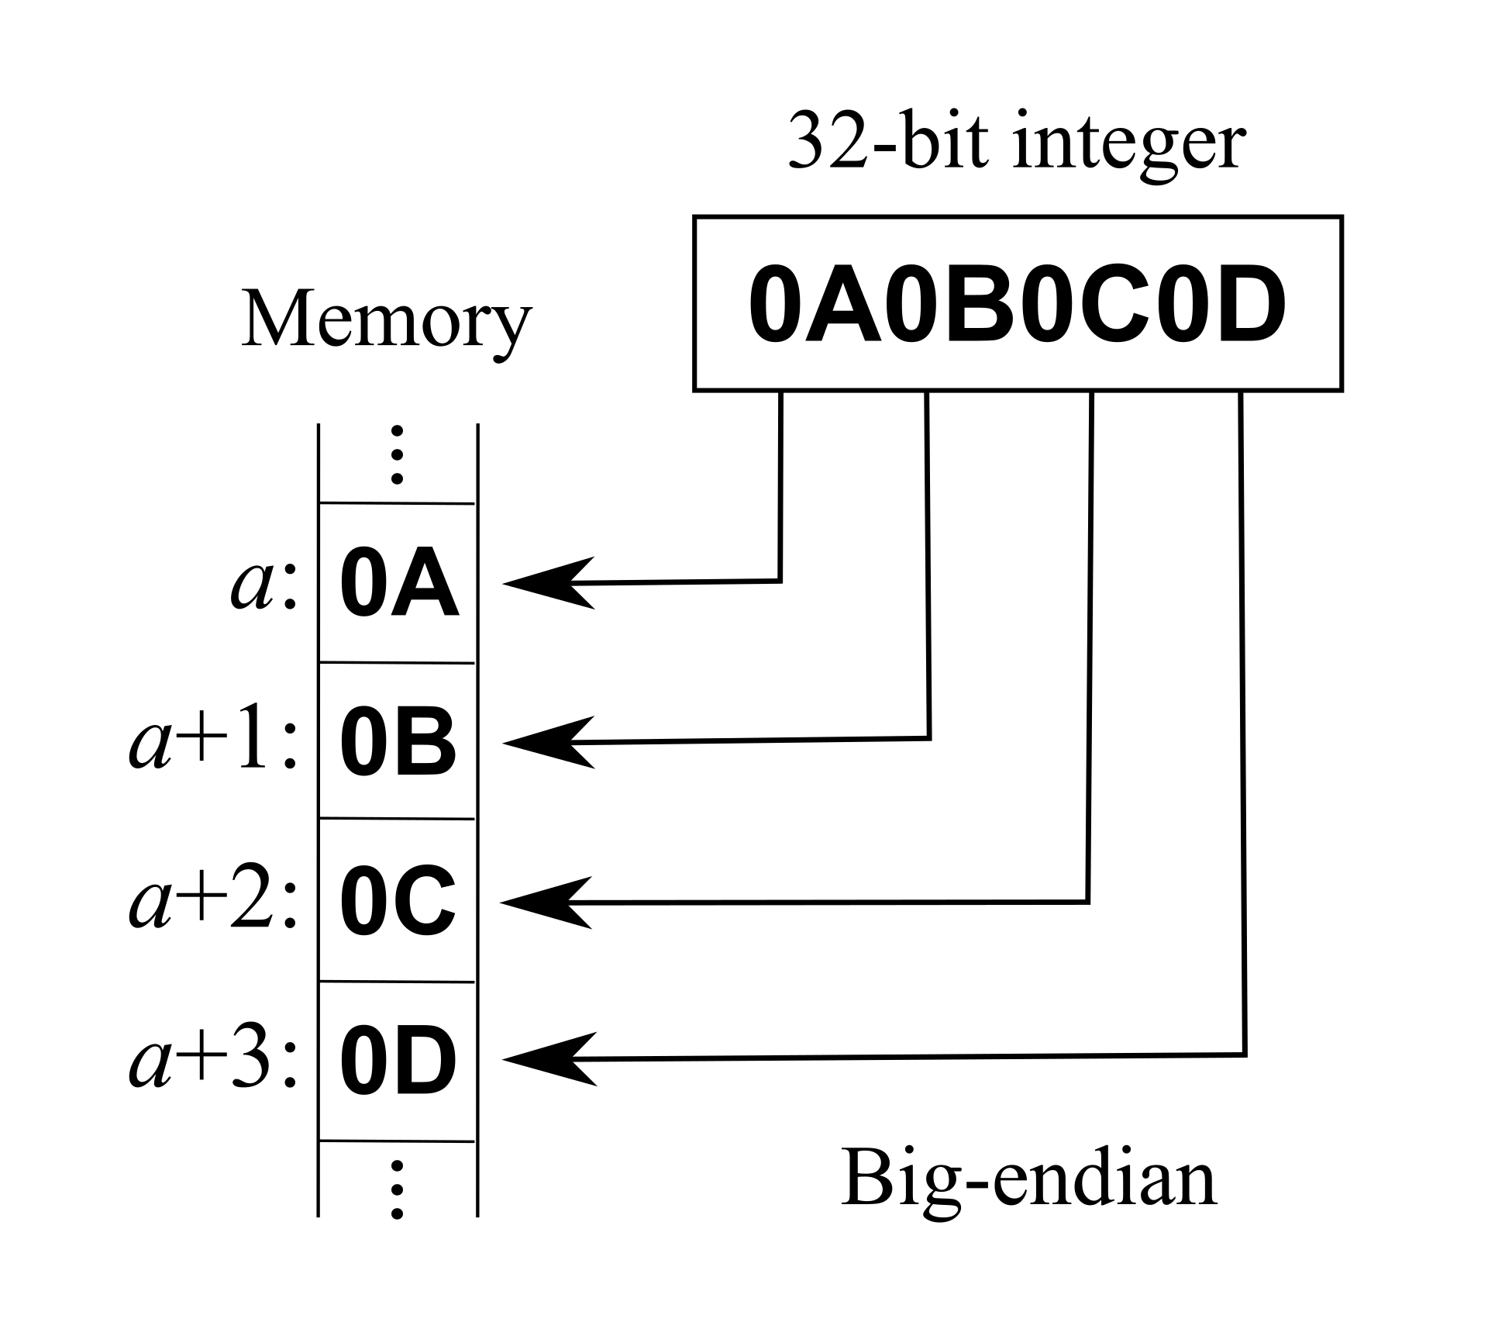
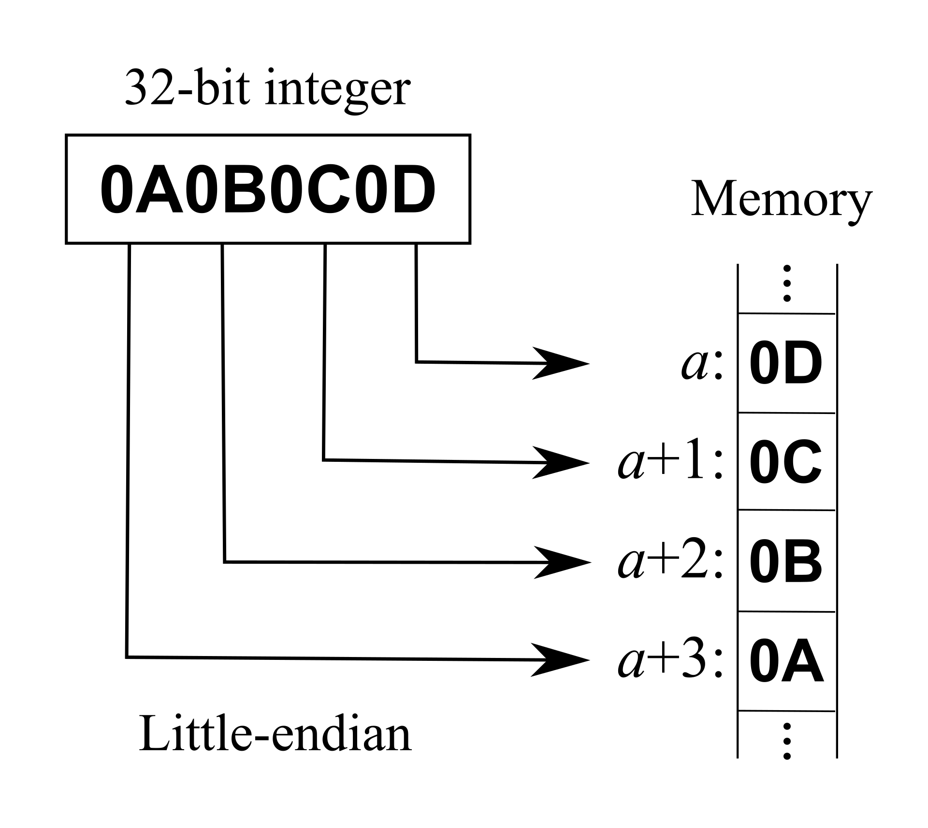
As an aside: Endianness

Slide 27
TASK: Pointers and Address Ranges
Goal
Determine whether pointers fall within certain address ranges, defined by an array.
Determine if the address stored in ptr is pointing to a byte that makes up some part of an array element for the passed array. The byte does not need to be the first byte of the array element that it is pointing to.
intArray: 0x0 size: 4 ptr: 0x0 return: 1
intArray: 0x0 size: 4 ptr: 0xF return: 1
intArray: 0x0 size: 4 ptr: 0x10 return: 0
intArray: 0x100 size: 30 ptr: 0x12A return: 1
intArray: 0x100 size: 30 ptr: 0x50 return: 0
intArray: 0x100 size: 30 ptr: 0x18C return: 0

Slide 28
TASK: Byte Traversal
Motive
Learn to read and write data by understanding the layout of the bytes.
Background
C strings do not not how ‘long’ they are (No .length() method).
We need to calculate this ourselves.
All C strings are arrays of characters that end with a null terminator, \0.
Goal
stringLength() - returns the length of a string, given a pointer to its beginning.
Note that the null terminator character does NOT count as part of the string length.
stringSpan (str1, str2) - returns the length of the initial portion of str1 which consists only of characters that are part of str2.
The search does NOT include the terminating null-characters of either strings, but ends there.

Slide 29
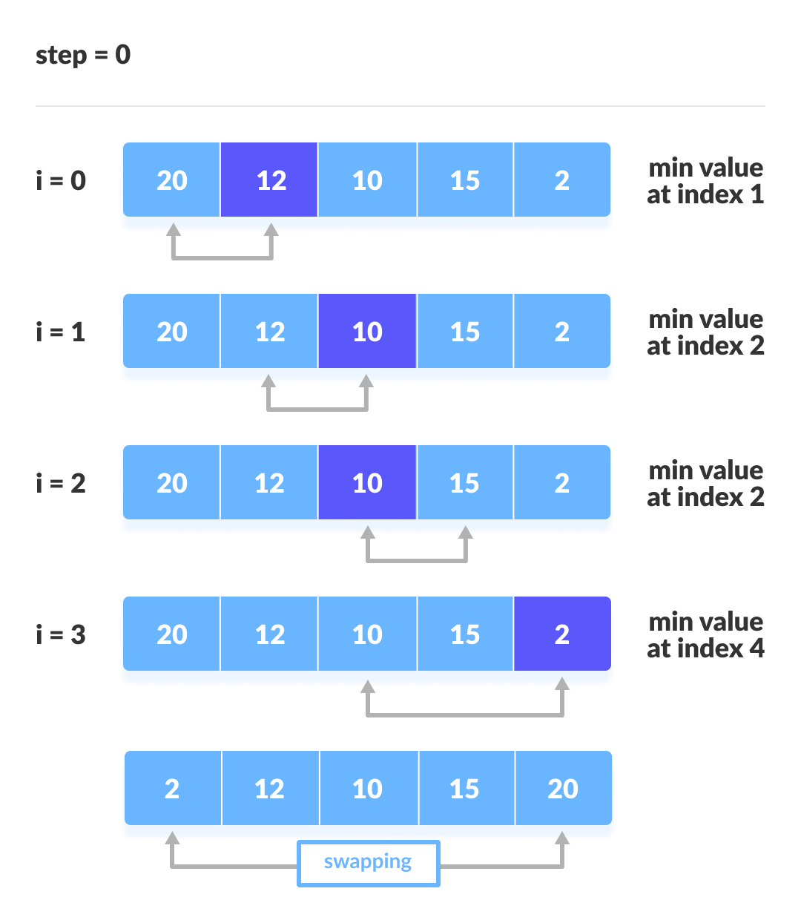
TASK: Selection Sort
Your final task is to implement selection sort
Just like 445… _{but in C}
You may use loops and if statements
But still no array syntax (array[])
Notes:
Hope you remember it from your data structure course
Or have your CS 0445 notes handy

Slide 30
In case you forgot…
Let:
arr:= array
n:= the length of arr
for i = 0 → (n-1)
minIndex = i
for j = (i+1) → n
if arr[minIndex] > arr[j]
minIndex = j
end if
end for
swap(arr[i], arr[minIndex])
end for

Slide 31
Evaluation
The following driver program has been provided to help you check the correctness of your work:
ptest
checks functional correctness: Does your solution produce the expected result?
To use:
Build using make
Run using ./ptest
You must rebuild each time you modify pointer.c
Gradescope Autograder may test your program on inputs that ptest does not check by default.
Coding style (restriction) will be checked by grader TA on Gradescope

